Slide 1
wegame
10152018 Sprint#1

Slide 2
1. Progress

Slide 3
genre
Action Adventure

Slide 4
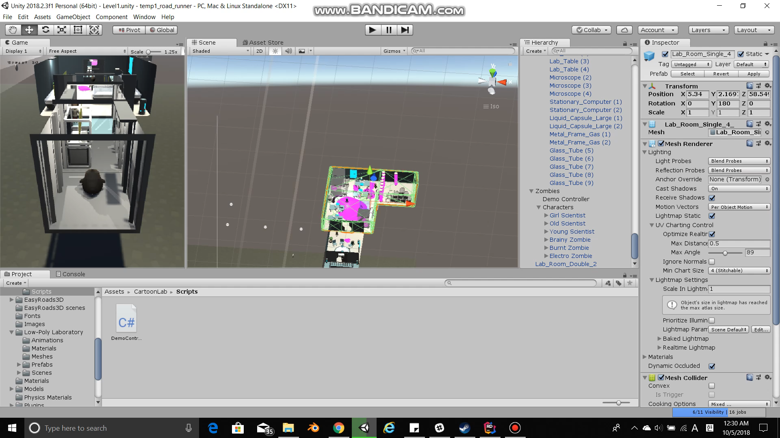
gameplay

Slide 5
gameplay
Player walks around and kills zombies.
Level up system
Unlock region of the planent

Slide 6
Pete the penguin
In the year 3000, human ignorance towards the issue of extreme climate has resulted in global disasters and degrading sanitation. Global warming has worsened to the point where the majority of human beings have turned into brainless creatures due to the massive expansion of May Virus. For the past decade, scientists have been trying to secure as many animals as possible, where the animal’s brains are gradually eaten out by the May Virus. Out of all animals, penguins are one of the last surviving species in this horrible catastrophe. As the scientists are still conducting experiments for the cure of May Virus in their lab in Irvine, California, brainless humans have broken into the lab, eating scientists and experiment subjects on their way into the underground lab space. As the emergency alarm sounds, the head of the scientist Pete Peng decided to transfer the consciousness of the remaining scientists into their securely protected penguins in the underground laboratory. The moment Pete the Penguin opened his eyes upon his new penguin body, countless human zombies turned their heads toward him…
At last, the May Virus is exterminated by Pete the Penguin. All animals slowly regained consciousness, whereas human civilians finally realized the significance of environmental protections.

Slide 7
2. Problems

Slide 8
assets
How to solve

Slide 9
Game mechanics
RPG
Free movement on the map, unlock each regions separately.
Able to attack/jump/take damage from mobs.

Slide 10
character
Pete the Penguin - main character
Yungchu – polar pig
Jia – polar cockroach
Michael – security guard
Ryan – polar ant

Slide 11
3. plan

Slide 12
Plan for following two weeks..?

